Slide 1
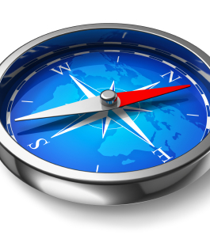
An application to save your navigation data
Made by Astrid Tanon Kouadio

Slide 2

Motivation
This native application records phone sensor data and can take a picture to have pictures of the car’s speedometer.
The purpose is to convert this data into a rumble signal.

Slide 3
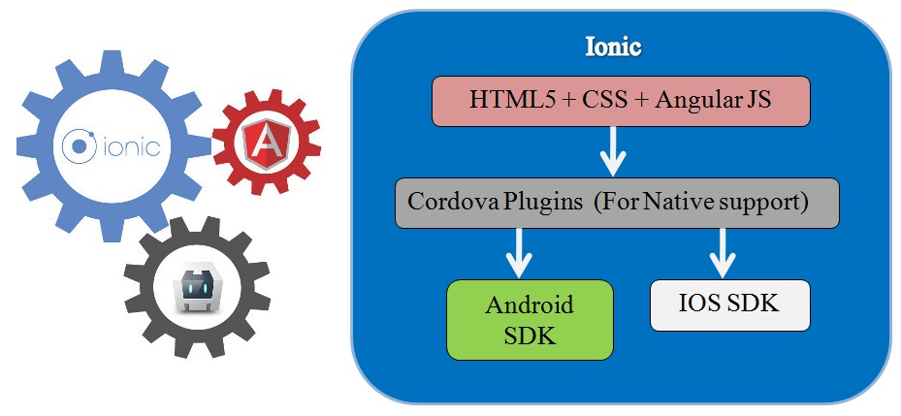
Introduction
Ionic :
is a framework free, open source for developping native app.
Has his own emulate autaumatically generated.
Design and deploy application on android, iOs and windows.

Slide 4
Application design
Navigation sensors (accelerometer,gps, gyroscope)
Creation of a sqlite database to save the data and export data

Slide 5
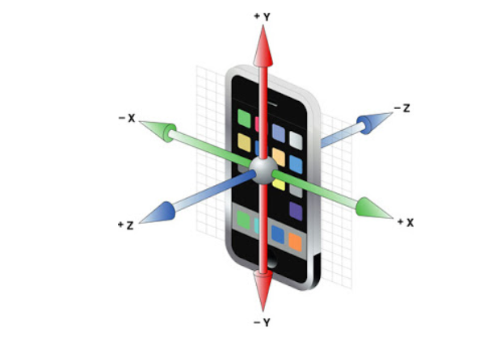
1/ Navigation sensor: The accelerometer
Measure the orientation, vibration and acceleration of a motion of a structure.
3 axes are defined: x, y and z. Those axes have a device’s acceleration value.
Units: meters per second squared (m/s^2)

Slide 6
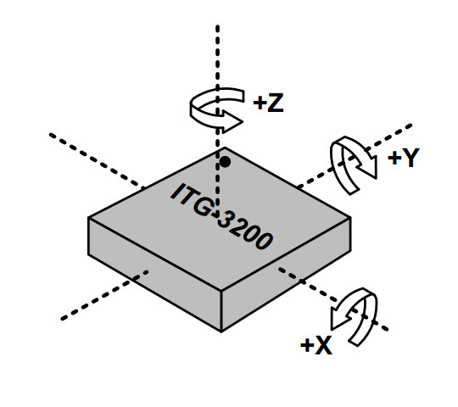
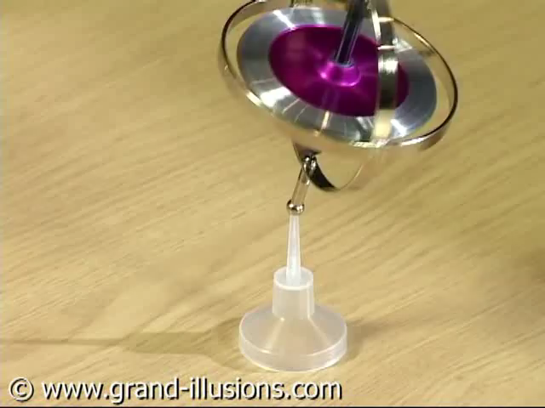
1/ Navigation sensor: The gyroscope
The gyroscope uses health gravity to determine the orientation of a structure.
3 axes are defined: x, y and z. Those axes have a device’s gyroscope value.
Units: degrees per second (°/s)

Slide 7
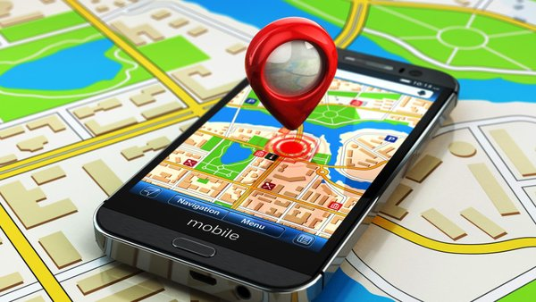
1/ Navigation sensor: The Geolocation/GPS
Gives the geographic location of the place where the user is. We get the lattitude and longitude.

Slide 8


2/ Creation of a database

Slide 9
Conclusion

Slide 10
Areas for improvement
Fréquence de sauvegarde des données
Améliorer le style de l’application

